Slide 1



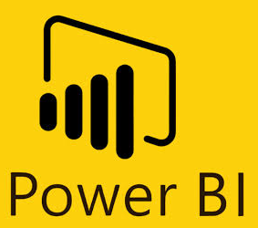




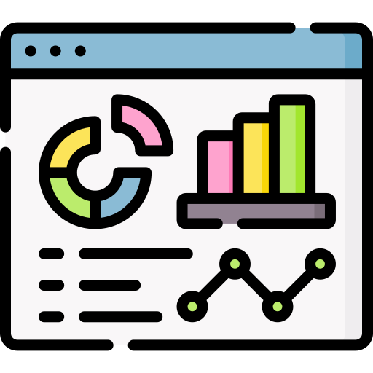









Real-Time Dashboard Reference Architecture
Data Source
Messaging Lawer
Reliable distributed storage and processing of large datasets (Big Data)
Visualization
Data Streaming
SQL Query Engine
Data Processing
Data Warehouse
Job Scheduler
Broken 1
Coordination Service
rawMsgTopic
Broken 2
rawMsgTopic
Central resource management component in the Apache Hadoop ecosystem
…Broken n
Storage of massive amounts of data (Big Data) on standard (commodity) hardware
rawMsgTopic
Web Application

